Slide 1
Working with Dates and Strings
chapter-8

Slide 2
WORKING WITH DATES AND TIMES
To work with dates and times in C#, you use the DateTime structure.
This structure provides a variety of properties and methods for getting information about dates and times, formatting DateTime values, and performing operations on dates and times.

Slide 3
HOW TO CREATE A DATETIME VALUE

Slide 4
HOW TO CREATE A DATETIME VALUE
You can use the new keyword to create a DateTime value from the DateTime structure.
When you create a DateTime value using the new keyword, you must always specify the year, month, and day.
In addition, you can optionally specify the time in hours, minutes, seconds, and milliseconds. If you don't specify the time, it's set to 12:00 AM.

Slide 5
HOW TO CREATE A DATETIME VALUE
You can also create a DateTime value using the static Parse or TryParse method of the DateTime structure.
When you use one of these methods, you specify the date and time as a string as illustrated in the next slide

Slide 8
HOW TO CREATE A DATETIME VALUE
Here, in the previous slide the first and the third statement specifies just a date. Because of that, the time portion of the DateTime value is set to 12:00 AM.
The second and the fourth statement specifies both a date and time.
The fifth statement illustrates that you can create a DateTime value from a property or variable that contains a date/ time string. In this case, a DateTime value is created from the Text property of a text box.
The last two statements show how you would perform the same processing as the fifth statement using the TryParse method

Slide 9
Date and Time formats
When you use the Parse or TryParse method to create a DateTime value, the date and time you specify must be in a valid format.
Some of the most common formats are listed in this figure

Slide 10
How to get the current date and time
There are two static properties of the DateTime structure that you can use to get the current date and time.
If you use the Now property, both the date and time are returned. If you use the Today property, only the date is returned, and the time is set to 12:00:00 AM.

Slide 14
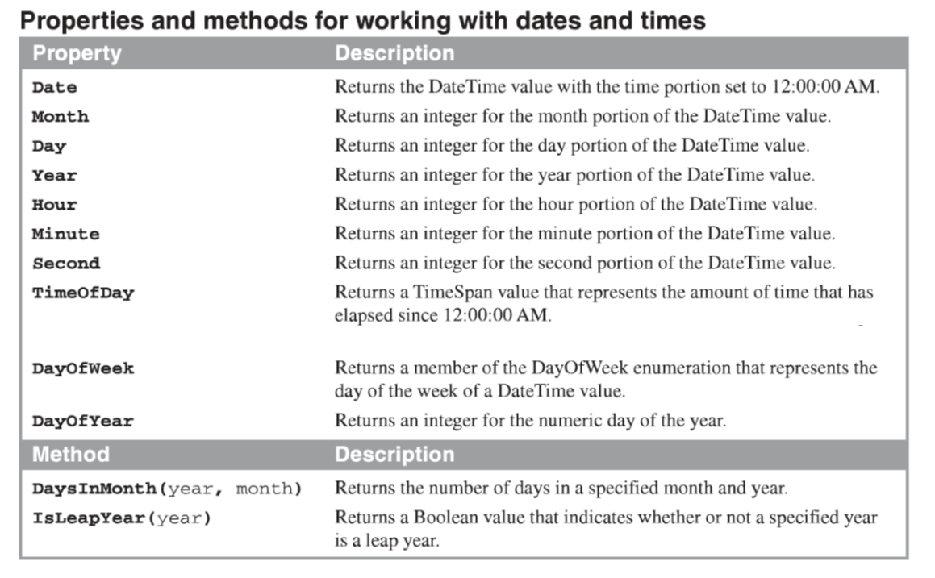

Slide 19
How to work with strings
When you create a string, you are actually creating a String object from the String class.
Then, you can use the properties and methods of the String class to work with the String object.

Slide 34
The StringBuiIder class
When you use the String class to create a string, the string has a fixed length and value.
In other words, the String class creates strings that are immutable.
Then, when you assign a new value to a string variable, the original String object is deleted and it's replaced with a new String object that contains the new value.

Slide 35
The StringBuiIder class
Another way to work with strings, though, is to use the StringBuilder class.
Then, you create StringBuilder objects that are mutable so you can add, delete, or replace characters in the objects.
This makes it easier to write some types of string-handling routines, and these routines run more efficiently.
As a result, you should use the StringBuilder class for string-handling routines that append, insert, remove, or replace characters in strings, especially if you 're working with long strings that use significant system resources.

Slide 38
The StringBuiIder class
The capacity of a StringBuilder object is the amount of memory that's allocated to it. That capacity is increased automatically whenever necessary.
If you don't set an initial capacity when you create a StringBuilder object, the default is 16 characters.
The StringBuilder class is a member of the System. Text namespace.

